Slide 1
TOPIC 5
CHEMICAL ENERGETICS
Taylor’s College Subang Jaya

Slide 2
THERMODYNAMICS
First Law Energy can be neither created nor destroyed but it can be
converted from one form to another
Energy changes all chemical reactions are accompanied by some form of energy
change changes can be very obvious (e.g. coal burning) but can go
unnoticed
Exothermic Energy is given out
Endothermic Energy is absorbed
Examples Exothermic combustion of fuels
respiration (oxidation of carbohydrates)
Endothermic photosynthesis
thermal decomposition of calcium carbonate

Slide 3
Exothermic reactions
Give out heat to the surrounding
Surrounding temperature _______
Heat content of the system _________
△H is _________

Slide 4
Endothermic reactions
absorb heat from the surrounding
Surrounding temperature _______
Heat content of the system _________
△H is _________

Slide 5
Exothermic reactions
Exothermic reactions are energetically more favourable than endothermic ones because a system with lower heat content is more stable compared to that with higher heat content.
Most chemical reactions are exothermic.

Slide 6
Enthalpy Change of Reaction, ∆H
unit : kJmol⁻¹
Standard State Conditions :
Pressure 1 atm
Temperature 298K or 25°C
A thermochemical equation summarises the information needed in the study of energetics.
Physical state symbol MUST be given in a thermochemical equation.

Slide 7
Standard Enthalpy Change of Reaction, ∆H
Standard Enthalpy change of Formation
Standard Enthalpy change of Combustion
Standard Enthalpy change of Atomisation
Standard Enthalpy change of Neutralisation
Standard Enthalpy change of Hydration
Standard Enthalpy change of Solution
Bond Energy

Slide 8
Standard Enthalpy Change of Formation, ∆H_{f}^{θ}
enthalpy change when 1 mol of a compound is formed from its elements in their standard states under standard conditions (25°C, 1 atm)
C(s) + O₂(g) CO₂(g)
H₂(g) + ½O₂(g) H₂O(l)
K(s) + Mn(s) + 2O₂(g) KMnO₄(s)

Slide 9
Standard Energy Change of Combustion, ∆H_{c}^{θ}
enthalpy change when 1 mol of a substance is burnt in an excess of oxygen under standard state condition (25°C, 1 atm)
C(s) + O₂(g) ———> CO₂(g)
H₂(g) + ½O₂(g) ———> H₂O(l)
C₂H₅OH(l) + 3O₂(g) ———> 2CO₂(g) + 3H₂O(l)

Slide 10
Bond Energy / Bond dissociation Energy
energy required to break 1 mole of a covalent bond between 2 atoms in its gaseous state.
Bond energy = value of bond ( either to break or to form covalent bond)
Exothermic change is evidence for formation of strong bonds,
Endothermic change is evidence for formation of weaker bonds.

Slide 11
BOND DISSOCIATION ENTHALPY
Notes • strength of bonds also depends on environment; MEAN values quoted
• making bonds is exothermic as it is the opposite of breaking a bond
• for diatomic gases, bond enthalpy = 2 x enthalpy of atomisation
• smaller bond enthalpy = weaker bond = easier to break
Mean Values H-H 436 H-F 562 N-N 163
C-C 346 H-Cl 431 N=N 409
C=C 611 H-Br 366 N≡N 944
C≡C 837 H-I 299 P-P 172
C-O 360 H-N 388 F-F 158
C=O 743 H-O 463 Cl-Cl 242
C-H 413 H-S 338 Br-Br 193
C-N 305 H-Si 318 I-I 151
C-F 484 P-H 322 S-S 264
C-Cl 338 O-O 146 Si-Si 176
Average (mean) values are quoted because the actual value depends on the environment of the bond i.e. where it is in the molecule
UNITS = kJ mol⁻¹

Slide 12
Standard Enthalpy Change for Atomisation, ∆H_{at}^{θ}
Enthalpy change to form 1 mole of gaseous atom from an element or a molecule under standard state condition (25°C, 1atm)
Always positive
½O₂₍g₎ → O₍g₎
Na(s) → Na(g)

Slide 13
Standard Enthalpy Change for Hydration, ∆H_{hdy}^{θ}
the enthalpy change when one mole of the gaseous ions is dissolved in a large amount of water standard state condition (25°C, 1atm)
Always negative
Reason : heat produced when bonds are
formed between the ions and the dipoles
on the water molecules.

Slide 14
Standard Enthalpy Change for Solution, ∆H_{sol}^{θ}
the enthalpy change when one mole of a substance dissolves in a large volume of solvent that addition of more solvent produces no further heat change under standard conditions (at 25°C , 1 atm)

Slide 15
Standard Enthalpy Change of Neutralisation, ∆H_{n}^{θ}
Energy released when 1 mole of water is formed from 1 mole of H⁺ ion and 1 mole of OH⁻ ions under standard state condition (25°C,1 atm).
H+(aq) + OH¯(aq) ———> H2O(l)
Notes:A value of -57kJ mol-1 is obtained when strong acids react with strong alkalis.

Slide 16
EXPERIMENTAL DETERMINATION OF ENTHALPY CHANGES
In an experiment, ∆H can be found by using the formula : ∆H = mc∆T
m= mass of solution (volume in cm³)
c= specific heat capacity of solution
4.18 Jg⁻¹K⁻¹
∆T= change in temperature

Slide 17
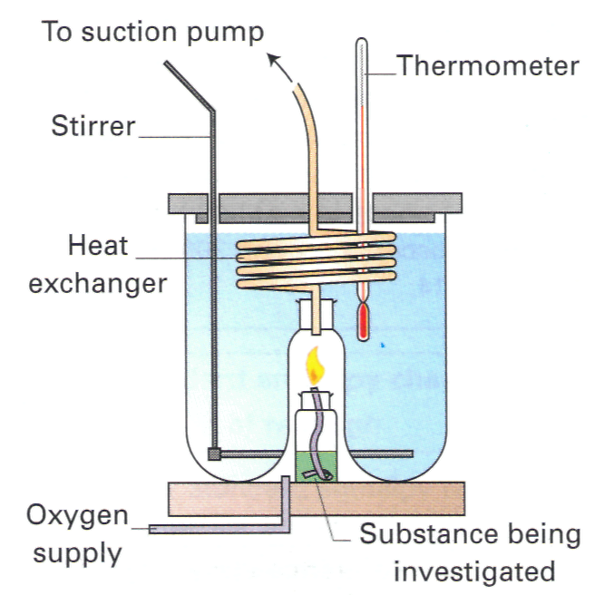
Measuring ∆Hc^{ѳ}
Using bomb calorimeter
q = mcΔT
q = heat (J)
m = mass of water (g)
c = specific heat capacity = 4.18 Jg⁻¹K⁻¹
ΔT = temperature change (K or °C)

Slide 18
Example
When 1.00 g of ethanol was burned under a container of water, it was found that 100 g of water was heated from 15°C to 65°C. Calculate the enthalpy change of combustion per mole of ethanol.
Step 1 : Calculate the heat using q = mcΔT
q = mcΔT
= 100 g x 4.18 Jg⁻¹K⁻¹ x (65 – 15)
= 2.09 x 10⁴ J = 20.9 kJ

Slide 19
Step 2 : Calculate the number of moles of ethanol used.
Num. of moles of ethanol used = 1.00/46 = 0.0217 mole
Step 3 : Calculate the enthalpy change per mole.
ΔH = heat evolved or absorbed
no. of moles of limiting reagent
0.0217 mole ethanol required 20.9 kJ
1 mole ethanol required 20.9 kJ = - 963.1 kJ mol⁻¹
0.0217 mol

Slide 20
Example calculation
When 0.18g of hexane underwent complete combustion, it raised the temperature of 100g water from 22°C to 47°C. Calculate its enthalpy of combustion.
Heat absorbed by the water (q) = mCΔT
= 0.1 x 4.18 x 25 = 10.45 kJ
Moles of hexane burned = mass / Mr
= 0.18 / 86 = 0.00209
Enthalpy change = heat energy / moles
= 10.45 / 0.00209
= - 5000 kJ mol ⁻¹

Slide 21
Calculation of ∆H^{ѳ}_{n}
Example:
On mixing 100 cm³ of 0.500 mol dm⁻³ HCl(aq) with 100 cm³
of 0.500 mol dm⁻³ NaOH(aq), the temperature of the
mixture rised by 3.4°C (both solutions were initially at the
same temperature). Calculate ∆H^{ѳ}_{n} .
[Assume all solutions have a density of 1.0 gcm-3]
Step 1 : q = mcΔT
q = [(100 + 100) x 4.2 x 3.4] J
= (200 x 4.2 x 3.4 ) J
= 2856 J

Slide 22
Step 2 : HCl + NaOH NaCl + H₂O
No. of moles of HCl, n = cV = 0.500 x (100/1000) = 0.05 mol
No. of moles of NaOH, n = cV = 0.500 x (100/1000) = 0.05 mol
∴No. of moles of H₂O formed = 0.500 mol
Step 3 : ∆H^{ѳ}_{n} = Heat evolved
no. of moles of H₂O formed
= -(2856/0.05) J mol⁻¹
= -57120 J mol⁻¹
= -57.1 kJ mol⁻¹

Slide 23
MEASURING ENTHALPY CHANGES
Example 2
25cm³ of 2.0M HCl was added to 30cm³ of 2.0M NaOH in an insulated beaker. The initial temperature of both solutions was 20°C. The highest temperature reached by the solution was 33°C. Calculate the Molar Enthalpy of Neutralisation. [The specific heat capacity (c) of water is 4.18 kJ K ⁻¹ kg ⁻¹]
NaOH + HCl ——> NaCl + H₂O
Heat absorbed by the water (q) = m x c x ΔΤ = 55 x 4.18 x 13 = 2.989 kJ
Moles of HCl reacting = 2 x 25/1000 = 0.05 mol (limiting reagent)
Moles of NaOH reacting = 2 x 30/1000 = 0.06 mol
Moles of water produced = 0.05 mol
Enthalpy change per mol (ΔΗ) = heat energy / moles of water = 2.989 / 0.05
= - 59.78 kJ mol ⁻¹

Slide 24
Bond Energy
Bond energy (of dissociation) Energy required to break 1 mole of a covalent bond between 2 atoms in gaseous state.
From the bond energy we can estimate the change of enthalpy in reactions.
Bond breaking endothermic process (energy absorbed).
Bond formation exothermic process (energy released).
Chemical reaction involve bond-breaking followed by bond-making.
∴Energy difference between bond breaking & bond-
making = ΔH

Slide 25
Estimation of Enthalpy Change From Bond Energy.
Example :
NH₃(g) + 3F₂(g) 3HF(g) + NF₃(g)
Bond | Average bond energy (kJmol⁻¹)
N – F | 390
F – F | 158
H – F | 562
N - F | 272

Slide 26
∴ΔH = ΔH bond-breaking - ΔH bond-making
= [3(390) + 3(158)] – [3(562) + 3(272)]
= -858 kJ mol⁻¹
Bond broken | Endothermic | Bond formed | Exothermic
3 N – F | 3 (390) | 3 H – F | 3 (562)
3 F –F | 3 (158) | 3 N – F | 3 (272)

Slide 27
Example
CH₄ + 2O₂ CO₂ + 2H₂O, ∆Hc^{ѳ} = -890 kJmol⁻¹
C₂H₆ + 3½O₂ 2CO₂ + 3H₂O, ∆Hc^{ѳ} = -1560 kJmol⁻¹
C₃H₈ + 5O₂ 3CO₂ + 4H₂O, ∆Hc^{ѳ} = -1560 kJmol⁻¹
All 3 reactions are exothermic energy released on bond-making (CO₂ & H₂O) > energy required in bond-breaking (alkane & O₂).

Slide 28
Hess's Law
the enthalpy change for a reaction from reactants to products, is constants regardless of route taken,
provided final and initial conditions are
the same.
Hess's Law is used to determine enthalpy changes that cannot be found by direct experiments.

Slide 29
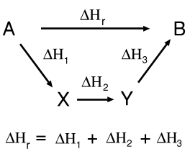
HESS’S LAW
How The enthalpy change going from
A to B can be found by adding the
values of the enthalpy changes for
the reactions A to X, X to Y and Y to B.
ΔΗ_{r} = ΔΗ₁ + ΔΗ₂ + ΔΗ₃
If you go in the opposite direction of an arrow, you subtract the value of
the enthalpy change.
e.g. ΔΗ₂ = - ΔΗ₁ + ΔΗ_{r} - ΔΗ₃
The values of ΔΗ₁ and ΔΗ₃ have been subtracted because the route
involves going in the opposite direction to their definition.

Slide 30
HESS’S LAW
“The enthalpy change is independent of the path taken”
Use applying Hess’s Law enables one to calculate enthalpy changes from
other data, such as...
changes which cannot be measured directly e.g. I.E
enthalpy change of reaction from bond energy
enthalpy change of reaction from ΔΗ°_{c}
enthalpy change of formation from ΔΗ°_{f}

Slide 31
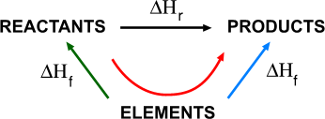
Enthalpy of reaction from enthalpies of formation
If you formed the products from their elements you should need the same amounts of every substance as if you formed the reactants from their elements.

Slide 32
Hess Law : Calculate ΔH from ∆H_{ƒ}^{ѳ}
Calculate the enthalpy change of reaction :
CaF₂ + H₂SO₄ 2HF + CaSO₄
Given : ∆H_{ƒ}^{ѳ} CaF₂ = -1220 kJ mol⁻¹
∆H_{ƒ}^{ѳ} H₂SO₄ = -814 kJ mol⁻¹
∆H_{ƒ}^{ѳ} HF = -271 kJ mol⁻¹
∆H_{ƒ}^{ѳ} CaSO₄ = -1434 kJ mol⁻¹

Slide 33
CaF₂ + H₂SO₄ 2HF + CaSO₄
Ca + H₂ + S + O₂ + F₂
By Hess Law :
ΔH = 2(-271) + (-1434) – (-1220) – (-814)
= +58 kJ mol⁻¹
∆H_{r}
-271
-1434
-1220
-814

Slide 34
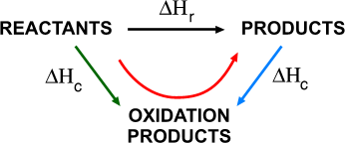
Enthalpy of reaction from enthalpies of combustion
If you burned all the products you should get the same amounts of oxidation products such a CO₂ and H₂O as if you burned the reactants.
Enthalpy of combustion is an exothermic process

Slide 35
Example
Given, ∆H_{c}^{ѳ}C(graphite) = -393 kJ mol⁻¹
∆H_{c}^{ѳ} CO (g) = -283 kJ mol⁻¹
Calculate the standard enthalpy change of formation of CO(g).

Slide 36
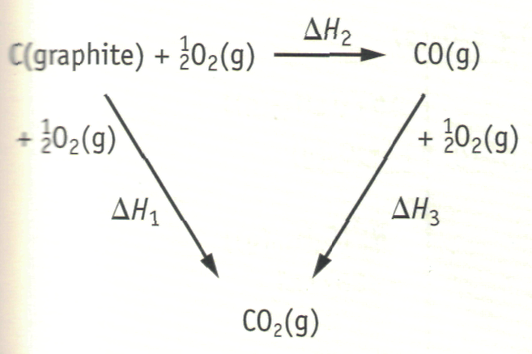
Step 1 : Draw the energy cycle.
By Hess Law : ∆H_{ƒ}^{ѳ} = ΔH₁ + (-ΔH₂)
= -393 – (-283)
= -110 kJ mol⁻¹

